Slide 1

The Best Table
The best comfort food in Centerville

Slide 2
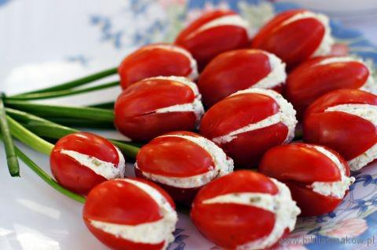

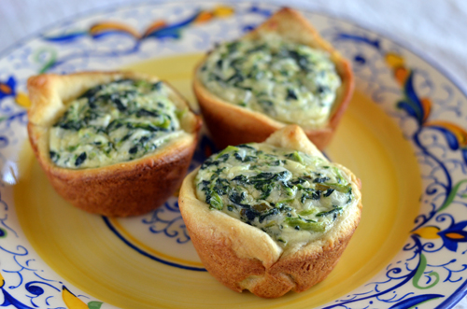
Appealing Appetizers
Cheese puffs
Stuffed cherry tomatoes
Marinated mushrooms
Mini spinach pies
Breads

Slide 3
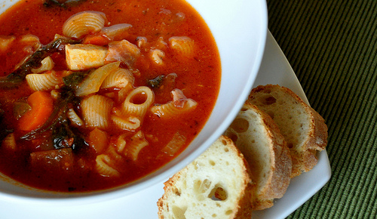
Comfort Food Main Dishes
Soups
Stews
Steaks and chops
Hearty vegetables

Slide 4
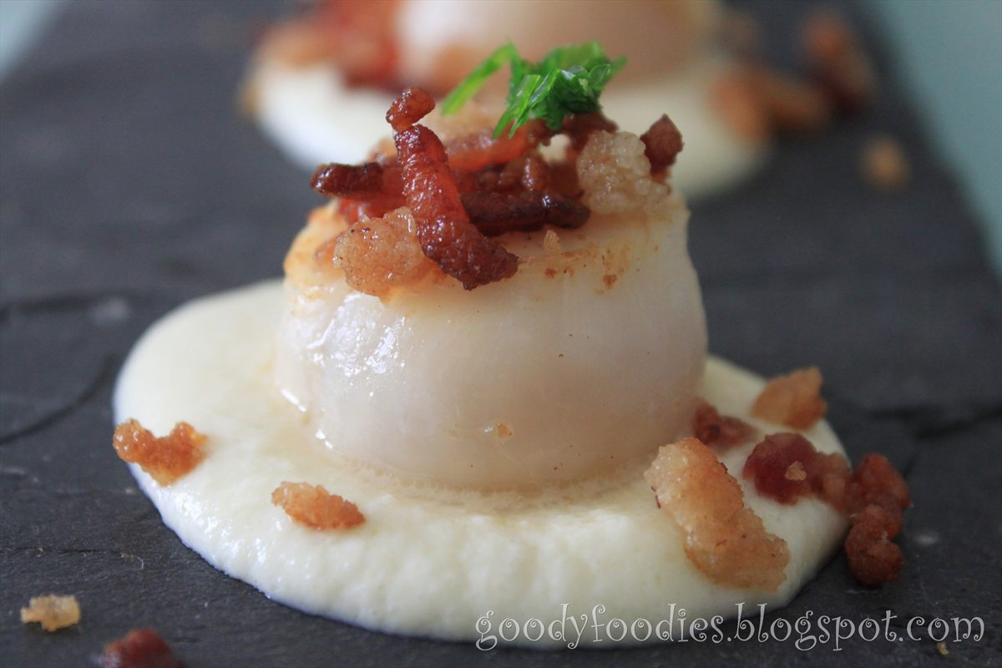
Warming Side Dishes
Corn pudding
Savory bread pudding
Veggie terrine
Warm potato salad with bacon
Cauliflower puree
Notes:
Awesome and tasty warming dishes

Slide 5
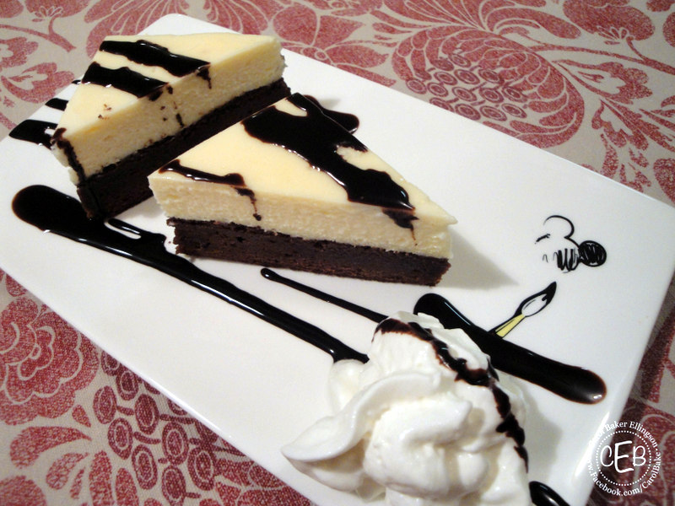

Delicious Desserts
Apple pie with ice cream
Maple bread pudding
Brownies with chocolate sauce
Pumpkin pie with whipped cream
Notes:
List of dishes

Slide 6
The Basics
Days | Hours
Tuesday– Thursday | 11 a.m. – 10 p.m.
Friday, Saturday, Sunday | 10 a.m. – 11 p.m.
Monday | Closed
Breakfast
Lunch
Dinner
Notes:
Basic starter food

Slide 7

Your table is The Best Table

